Slide 1

Li A , Huang W , Lan X , et al. Boosting Few-Shot Learning With Adaptive Margin Loss[J]. 2020.
Boosting Few-Shot Learning With Adaptive Margin Loss
Changtong Zan
20200619
Li A , Huang W , Lan X , et al. Boosting Few-Shot Learning With Adaptive Margin Loss[J]. 2020.

Slide 2
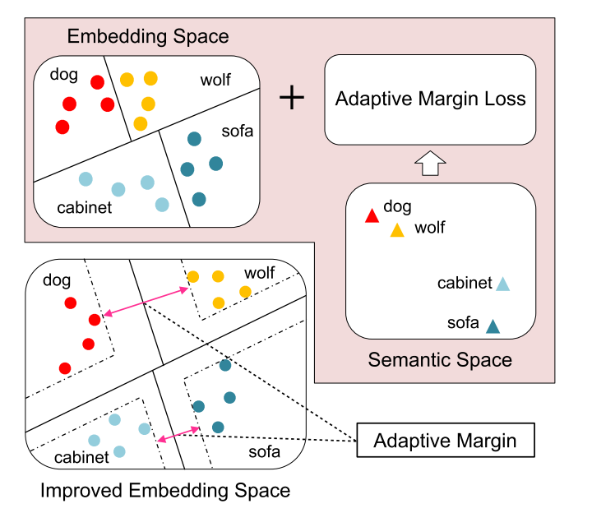
Boosting Few-Shot Learning With Adaptive Margin Loss
This paper proposes an adaptive margin principle to improve the generalization ability of metric-based meta-learning approaches for few-shot learning problems.
The contributions of this work are as follows:
This is the first work to propose an adaptive margin principle to improve the performance of current metric-based meta-learning approaches for FSL.
They propose a task-relevant adaptive margin loss to well distinguish samples from different classes in the embedding space according to their semantic similarity.
This approach can be easily extended to a more realistic yet more challenging generalized FSL setting.

Slide 3
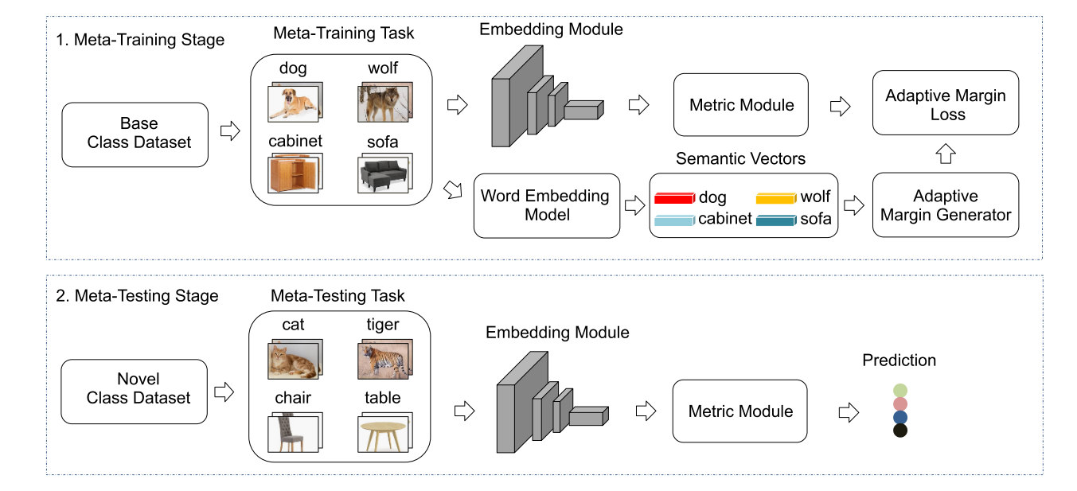

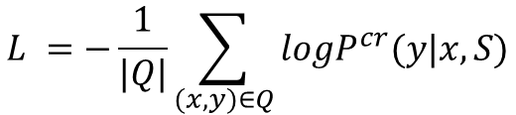
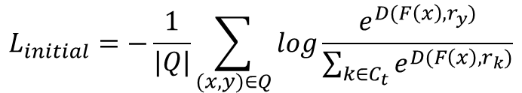
Boosting Few-Shot Learning With Adaptive Margin Loss
The classification loss can be formulated as:
$$L_{initial}=−\frac{1}{|Q|}\sum_{(x,y)∈Q}{log\frac{e^{D(F\left(x\right), r_{y})}}{\sum_{k∈C_{t}}{e^{D(F\left(x\right), r_{k})}}}}$$
The improved version:
$$L =−\frac{1}{|Q|}\sum_{(x,y)∈Q}{logP^{cr}(y|x,S)}$$
where
$P^{cr}(y|x,S$) = $\frac{e^{D(F\left(x\right), r_{y})}}{\sum_{k∈C_{t}\backslash \{y\}}{e^{D\left(F\left(x\right), r_{k}\right)+m}}+e^{D(F\left(x\right), r_{y})}}$

Slide 4
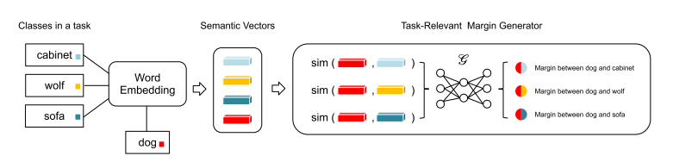




Boosting Few-Shot Learning With Adaptive Margin Loss
$P^{cr}(y|x,S$) = $\frac{e^{D(F\left(x\right), r_{y})}}{\sum_{k∈C_{t}\backslash \{y\}}{e^{D\left(F\left(x\right), r_{k}\right)+m}}+e^{D(F\left(x\right), r_{y})}}$
the margin between similar classes should be larger than the one between dissimilar classes
V1: Naïve additive margin loss
$$m=c$$
V2: Class-related
$$m=asin\left(e_{i}, e_{j}\right)+b$$
V3: task-related
$$m=G({\left\{sin\left(e_{i}, e_{j}\right)\right\}}_{k∈C_{t}\backslash \{y\}})$$

Slide 5
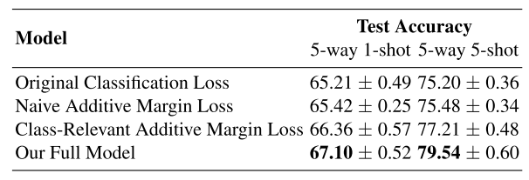
Boosting Few-Shot Learning With Adaptive Margin Loss
$P^{cr}(y|x,S$) = $\frac{e^{D(F\left(x\right), r_{y})}}{\sum_{k∈C_{t}\backslash \{y\}}{e^{D\left(F\left(x\right), r_{k}\right)+m}}+e^{D(F\left(x\right), r_{y})}}$
the margin between similar classes should be larger than the one between dissimilar classes
V1: Naïve additive margin loss
$$m=c$$
V2: Class-related
$$m=asin\left(e_{i}, e_{j}\right)+b$$
V3: task-related
$$m=G({\left\{sin\left(e_{i}, e_{j}\right)\right\}}_{k∈C_{t}\backslash \{y\}})$$

Slide 6
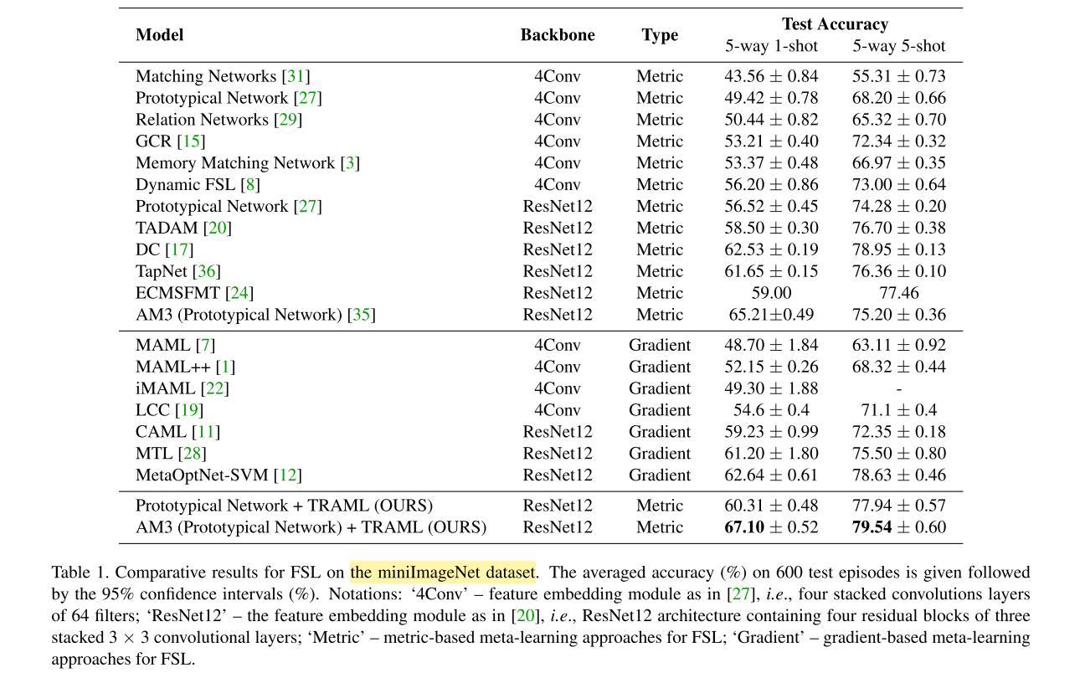
Boosting Few-Shot Learning With Adaptive Margin Loss

Slide 7
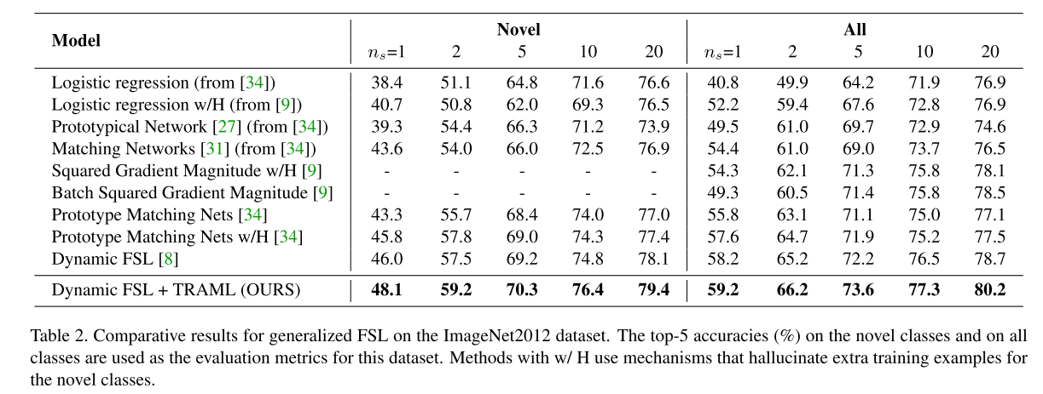
Boosting Few-Shot Learning With Adaptive Margin Loss

Slide 8
Thanks

